Slide 1
DIGITAL FORENSICS // IDS/IPS ANALYSIS
Understanding
Snort Rules
alert tcp any any -> any 80 (
msg:
"HTTP Detect";
sid:1000001;
)
Mustafa Mohammad Majdi
Mustafa Maher Ramzi
IDS/IPS
PCRE
Pattern Matching
Malware Detection
Network Forensics

Slide 2
01 // INTRODUCTION
Understanding Snort Rules
Snort Modes
3 Core Modes
Sniffer Mode
01
Flags: -v -d -e -i <interface>
$ snort -v -d -e -i eth0
Reads IP packets off the network and streams them to the console — headers, payload and data-link layer details.
Packet Logger Mode
02
Flags: -dev -l <log-dir> -h <network/CIDR>
$ snort -dev -l ./log -h 192.168.1.0/24
Captures every inbound and outbound IP packet and writes them to disk, organised in a directory hierarchy by IP address.
NIDS / NIPS Mode
03
Flags: -d -h <net> -l <log> -c snort.conf
$ snort -d -h 192.168.1.0/24 -l ./log -c snort.conf
Most powerful mode: analyses real-time traffic against user-defined rules — generates alerts, logs events, or blocks threats inline.

Slide 3
02 // RULE STRUCTURE
Understanding Snort Rules
Anatomy of a Snort Rule
Every Snort rule consists of exactly TWO parts: a Rule Header and Rule Options
alert tcp $EXTERNAL_NET any -> $HOME_NET 80 (msg:"ET WEB_SERVER SQL Injection Attempt"; content:"union"; nocase; sid:2001219; rev:8;)
RULE HEADER
RULE OPTIONS
Rule Header Components
Rule Option Keywords
Action — alert | log | pass | drop | reject
Protocol — tcp | udp | icmp | ip
Source IP — $EXTERNAL_NET / any / CIDR
Source Port — any / 80 / !443 / [80,8080]
Direction — -> (uni) or <> (bi-directional)
Dest IP & Port — $HOME_NET / specific
msg — Human-readable alert message
content — Payload byte pattern match
pcre — Perl-Compatible Regular Expression
sid / rev — Unique rule ID / revision
flags — TCP flags (SYN, ACK, FIN, RST…)
classtype — Attack classification category

Slide 4
03 // RULE HEADER
Understanding Snort Rules
Rule Header: Deep Dive
ACTION
PROTOCOL
alert | log | pass | drop | reject | sdrop
tcp | udp | icmp | ip
Defines what Snort does when a match is found. 'alert' generates an alert AND logs. 'drop' (inline mode) silently blocks the packet.
Layer 4 protocol filter. 'ip' matches all. Used to scope rule performance — avoid broad protocols unless necessary.
SOURCE IP
SOURCE PORT
$EXTERNAL_NET | any | 192.168.0.0/24
any | 80 | !443 | [80,8080:8090]
Supports CIDR notation, negation (!), lists [ip1,ip2], and Snort variables like $HOME_NET defined in snort.conf.
Port ranges (80:1024), negation (!80), comma-separated lists. Critically impacts detection engine performance.
DIRECTION
DEST IP & PORT
-> unidirectional
<> bidirectional
$HOME_NET | any | specific
'->' is asymmetric: SRC → DST. Use '<>' for protocols like FTP where data flows both ways (command + data channels).
Mirror of source fields. Snort variables ($HTTP_SERVERS, $SQL_SERVERS) reduce false positives and improve targeting.

Slide 5
04 // RULE OPTIONS
Understanding Snort Rules
Rule Options: Keywords & Categories
GENERAL
DETECTION
FLOW / STATE
THRESHOLD & RESPONSE
msg:
content:
flow:
threshold:
Human-readable label: msg:"Malware Beacon"
Payload byte pattern: content:"GET /malware.exe". Supports | hex | encoding
TCP stream direction: to_server,established — avoids matching handshake noise
Rate-limits alerts: type limit,track by_src,count 5,seconds 60
sid:
pcre:
flags:
priority:
Unique signature ID. <100 = reserved; 100-999999 = Snort; 1000000+ = local rules
Regex engine: pcre:"/passwd/i". Most powerful but CPU-expensive
TCP flag inspection: flags:S (SYN scan), flags:SF (stealth FIN scan)
Alert severity 1 (highest) to 10 (lowest) — feeds SIEM triage logic
rev:
nocase
dsize:
metadata:
Rule revision number. Always increment when modifying an existing rule
Case-insensitive content matching modifier
Payload size filter: dsize:0; matches empty payloads (C2 heartbeats)
Attaches MITRE ATT&CK IDs, CVE references, affected_product info
classtype:
distance:/within:
byte_test:
reference:
Pre-defined attack category (trojan-activity, web-application-attack, etc.)
Relative anchoring of multiple content patterns in sequence
Binary field comparison — critical for protocol-level malware analysis
Links to CVE/BugTraq/Snort SID DB: reference:cve,2021-44228

Slide 6
05 // DETECTION LOGIC
Snort Processing Pipeline
How Snort processes network traffic from capture to alert
01
02
03
Packet Capture
Packet Decoder
Preprocessors
Sniff raw packets from NIC via libpcap
Parse Ethernet, IP, TCP/UDP protocol layers
Stream reassembly, defrag, normalize
04
05
06
Detection Engine
Rule Evaluation
Output Plugins
Aho-Corasick multi-pattern match in single pass
Check rule headers, options chain, trigger alerts
Log to Unified2, syslog, PCAP, SIEM integration
Network Traffic ▸ Capture ▸ Decode ▸ Process ▸ Detect ▸ Evaluate ▸ Alert / Log

Slide 7
06 // PRACTICAL RULE WRITING
Understanding Snort Rules
Practical Rule Writing: Case Study
⚠ WannaCry / MS17-010
Scenario: Detect WannaCry SMB Exploit (EternalBlue / MS17-010) lateral movement over port 445
SNORT RULE
alert tcp $EXTERNAL_NET any -> $HOME_NET 445
(msg:"ET EXPLOIT MS17-010 WannaCry SMB";
flow:to_server,established; content:"|FF|SMB"; depth:5; pcre:"/\x00Trans2/"; metadata:cve 2017-0144; classtype:attempted-admin; sid:2024217; rev:5;)
RULE BREAKDOWN
Flow State Filter
SMB Magic Bytes
flow:to_server,established
content:"|FF|SMB"; depth:5
Only inspect established TCP sessions going TO port 445. Eliminates handshake noise — reduces false positives dramatically.
Hex pattern matching for SMB signature. |FF| is 0xFF. depth:5 limits search to first 5 bytes of payload for performance.
PCRE for Trans2 Request
MITRE / CVE Linkage
pcre:"/\x00Trans2/"
metadata:cve 2017-0144
Regex detects the Trans2 sub-command byte used by EternalBlue. Runs AFTER content pre-filter — prevents engine overhead.
Attaches CVE-2017-0144 to the alert. Enables automated SIEM correlation in Splunk, Elastic, and MISP threat-intel platforms.

Slide 8
07 // ADVANCED FEATURES
Understanding Snort Rules
Advanced Rule Features
byte_test — Binary Protocol Inspection
PCRE Cheat Sheet
byte_test:4,>,0x1000,0,relative;
/cmd\.exe/i – case-insensitive
/[\x41-\x5A]{50,}/ – long caps
/(?:UNION|SELECT)/i – SQL injection
/^GET\/[^\/]{200,}/ – long URI
/\x4D\x5A.{0,512}\x50\x45/s – PE header
Extracts N bytes from a payload offset and compares as integer. Essential for detecting malformed protocol headers in C2 channels and buffer overflows.
isdataat — Payload Existence Check
isdataat:512,relative;
Tests whether data exists at a byte offset. Detects unusually long fields indicating buffer overflow attempts. Pairs with content + distance for chained detection.
Threshold Tuning
urilen — URL Length Anomaly Detection
threshold: type both, track by_src, count 10, seconds 60;
Fire alert once per src IP per minute only after 10 matches — prevents brute-force alert floods while catching scans.
urilen:>500;
Fires when URL length exceeds a threshold. Detects SQL injection (UNION SELECT chains), XSS payloads, and path traversal attacks against web apps.

Slide 9
08 // FORENSICS & MALWARE
Understanding Snort Rules
Snort in Digital Forensics & Malware Analysis
Forensic Applications
Malware Family → Snort Signature Mapping
Network Traffic Reconstruction
WannaCry
EternalBlue exploit byte pattern matching in Trans2 SMB sub-commands
Unified2 log format feeds Wireshark, tcpdump, and NetworkMiner. Log all packets related to an alert for full session replay. Critical for post-breach timeline reconstruction.
SMB/445
Mirai Botnet
Brute-force login strings + 'busybox' payload; threshold on failed auths
C2 Beacon Detection
Telnet/23
Periodic outbound connections with consistent timing intervals (dsize:0, flow:established,to_server) fingerprint malware heartbeats — Cobalt Strike, Metasploit, and RATs use predictable patterns.
Emotet
Malformed User-Agent strings + encoded POST body patterns; PCRE on binary blobs
HTTP/443
Data Exfiltration Indicators
Cobalt Strike
Default malleable C2 profile headers; Beacon URI regex patterns match /jquery-3.3.1.min.js
Monitor anomalous outbound volumes using byte counters. Rules targeting DNS over TCP, unusually large ICMP payloads, or FTP transfers to unknown external IPs.
HTTP/S C2
Dridex
DGA domain characteristics; binary format of HTTPS POST payloads with byte_test
Lateral Movement Detection
HTTPS/P2P
Cross-host SMB/RDP/WMI anomalies. Writing Snort rules that trigger on internal traffic (HOME_NET → HOME_NET) catches worm propagation and pass-the-hash attacks.
BlackMatter
Encrypted channel detection via dsize anomalies + flow state + timing threshold rules
SMB/RDP

Slide 10
09 // BEST PRACTICES
Understanding Snort Rules
Rule Writing Methodology & Best Practices
01
Be Specific, Not Broad
02
Use Snort Variables
03
Anchor Your Patterns
Use flow:, proto, and dsize filters before content/pcre. Broad rules create alert fatigue and miss real threats hidden in the noise.
$HOME_NET, $EXTERNAL_NET, $HTTP_SERVERS — always prefer variables over hardcoded IPs. They adapt to environment changes without rule rewrites.
Always use depth:, offset:, distance:, within: to constrain where pattern matching occurs. Unanchored content rules are slow and generate false positives.
04
Test Before Deploying
05
Leverage Talos Intelligence
06
Document & Version Control
Use tcpreplay to replay PCAP files against your rules in test mode (snort -A console -r test.pcap). Never push untested rules to production IPS.
Cisco Talos (ET Open rules, Snort community rules) provides production-quality signatures. Study their methodology — read SIDs 2000000+ for real-world patterns.
Always increment rev:, use metadata: for CVE/MITRE ATT&CK tags, and maintain rules in Git. Correlate rule changes to threat intelligence updates.

Slide 11
LAB

Slide 12
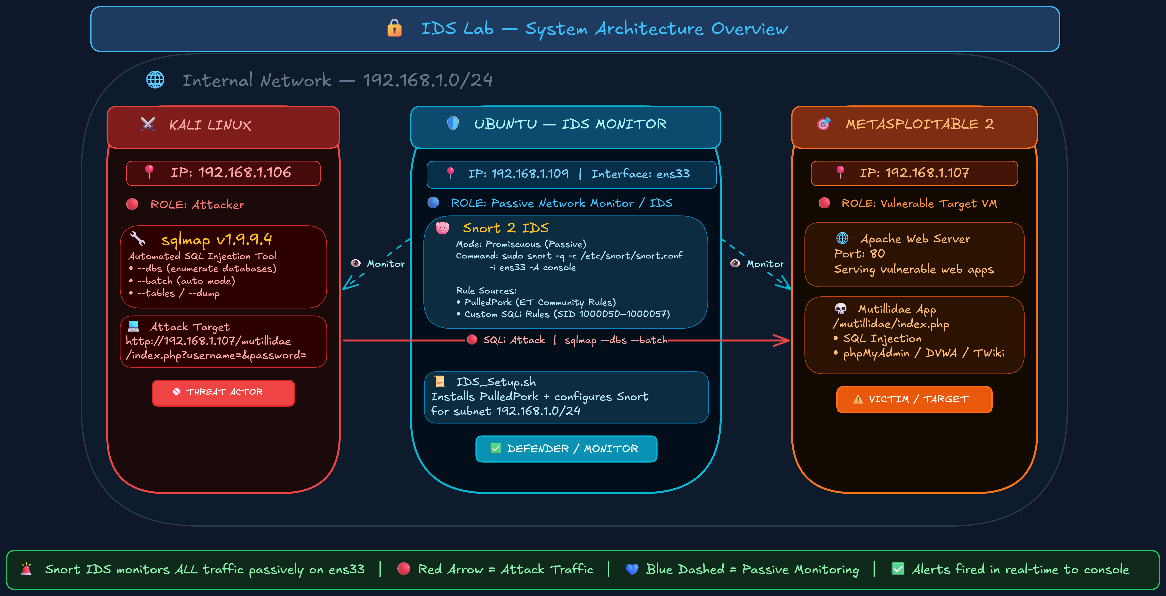

Slide 13




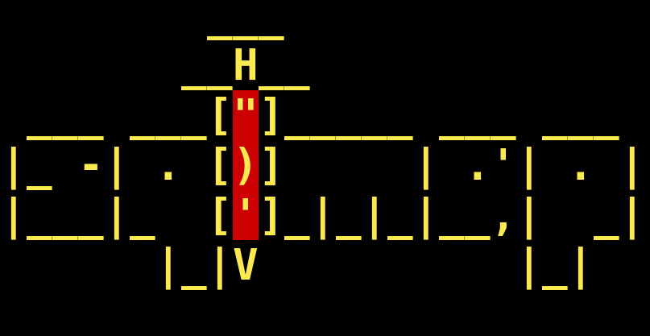
LAB Requirements
Kali
Ubuntu
Metasploitable 2

Slide 14
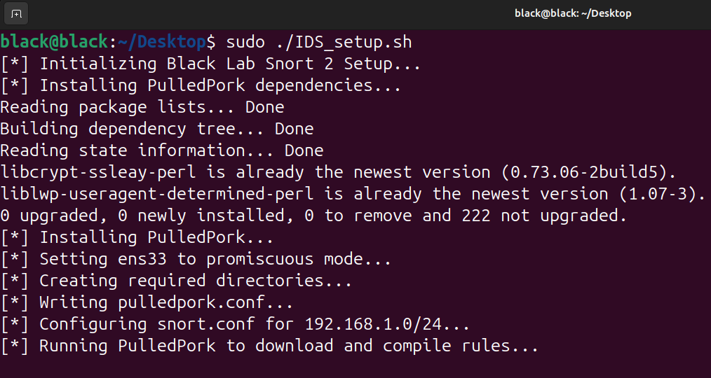

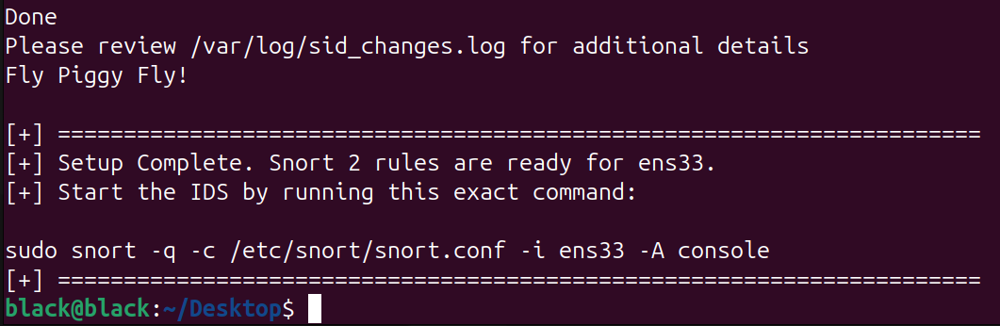
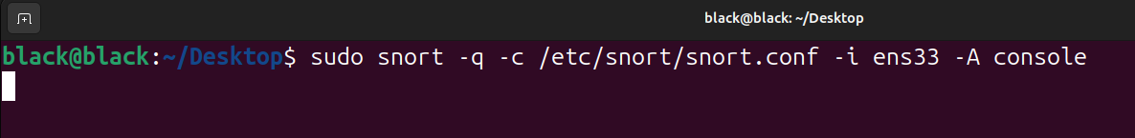
IDS_Setup.sh
IP: 192.168.1.109
Ubuntu

Slide 15
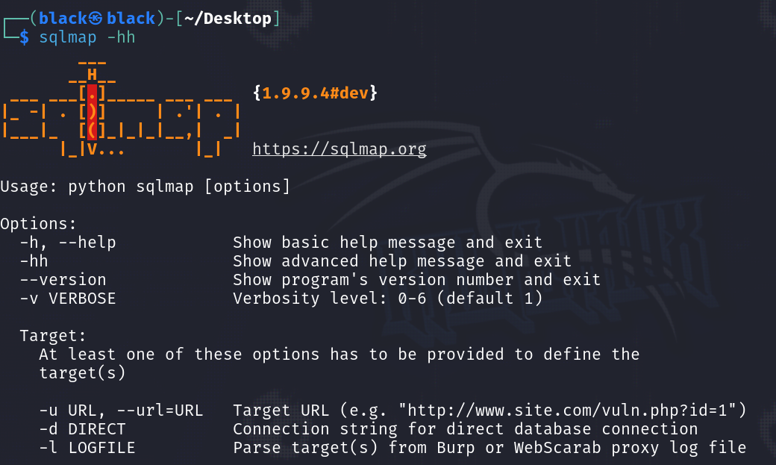
IP: 192.168.1.106
Kali

Slide 16
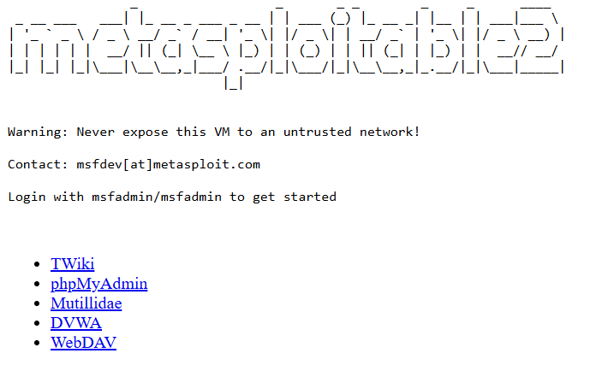
IP: 192.168.1.107
Web Server Is Running
Metasploitable 2

Slide 17
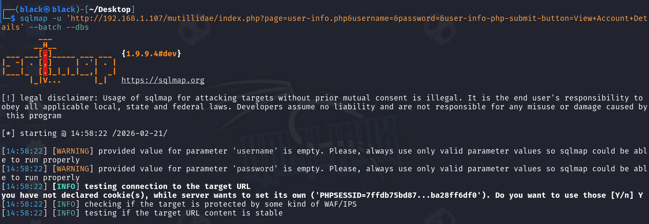
IP: 192.168.1.106
Starting The attack
Kali

Slide 18
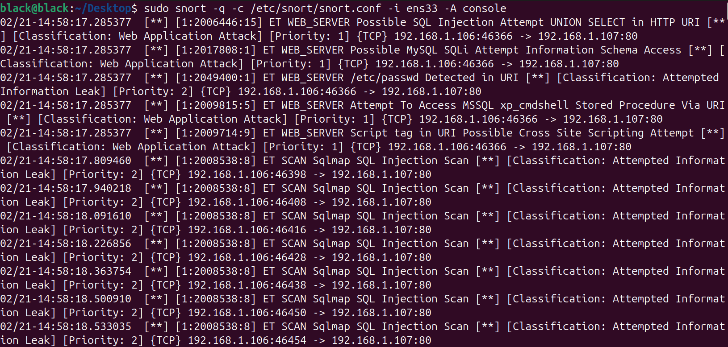
IP: 192.168.1.109
Snort IDS detected the sql injection payloads
Ubuntu

Slide 19
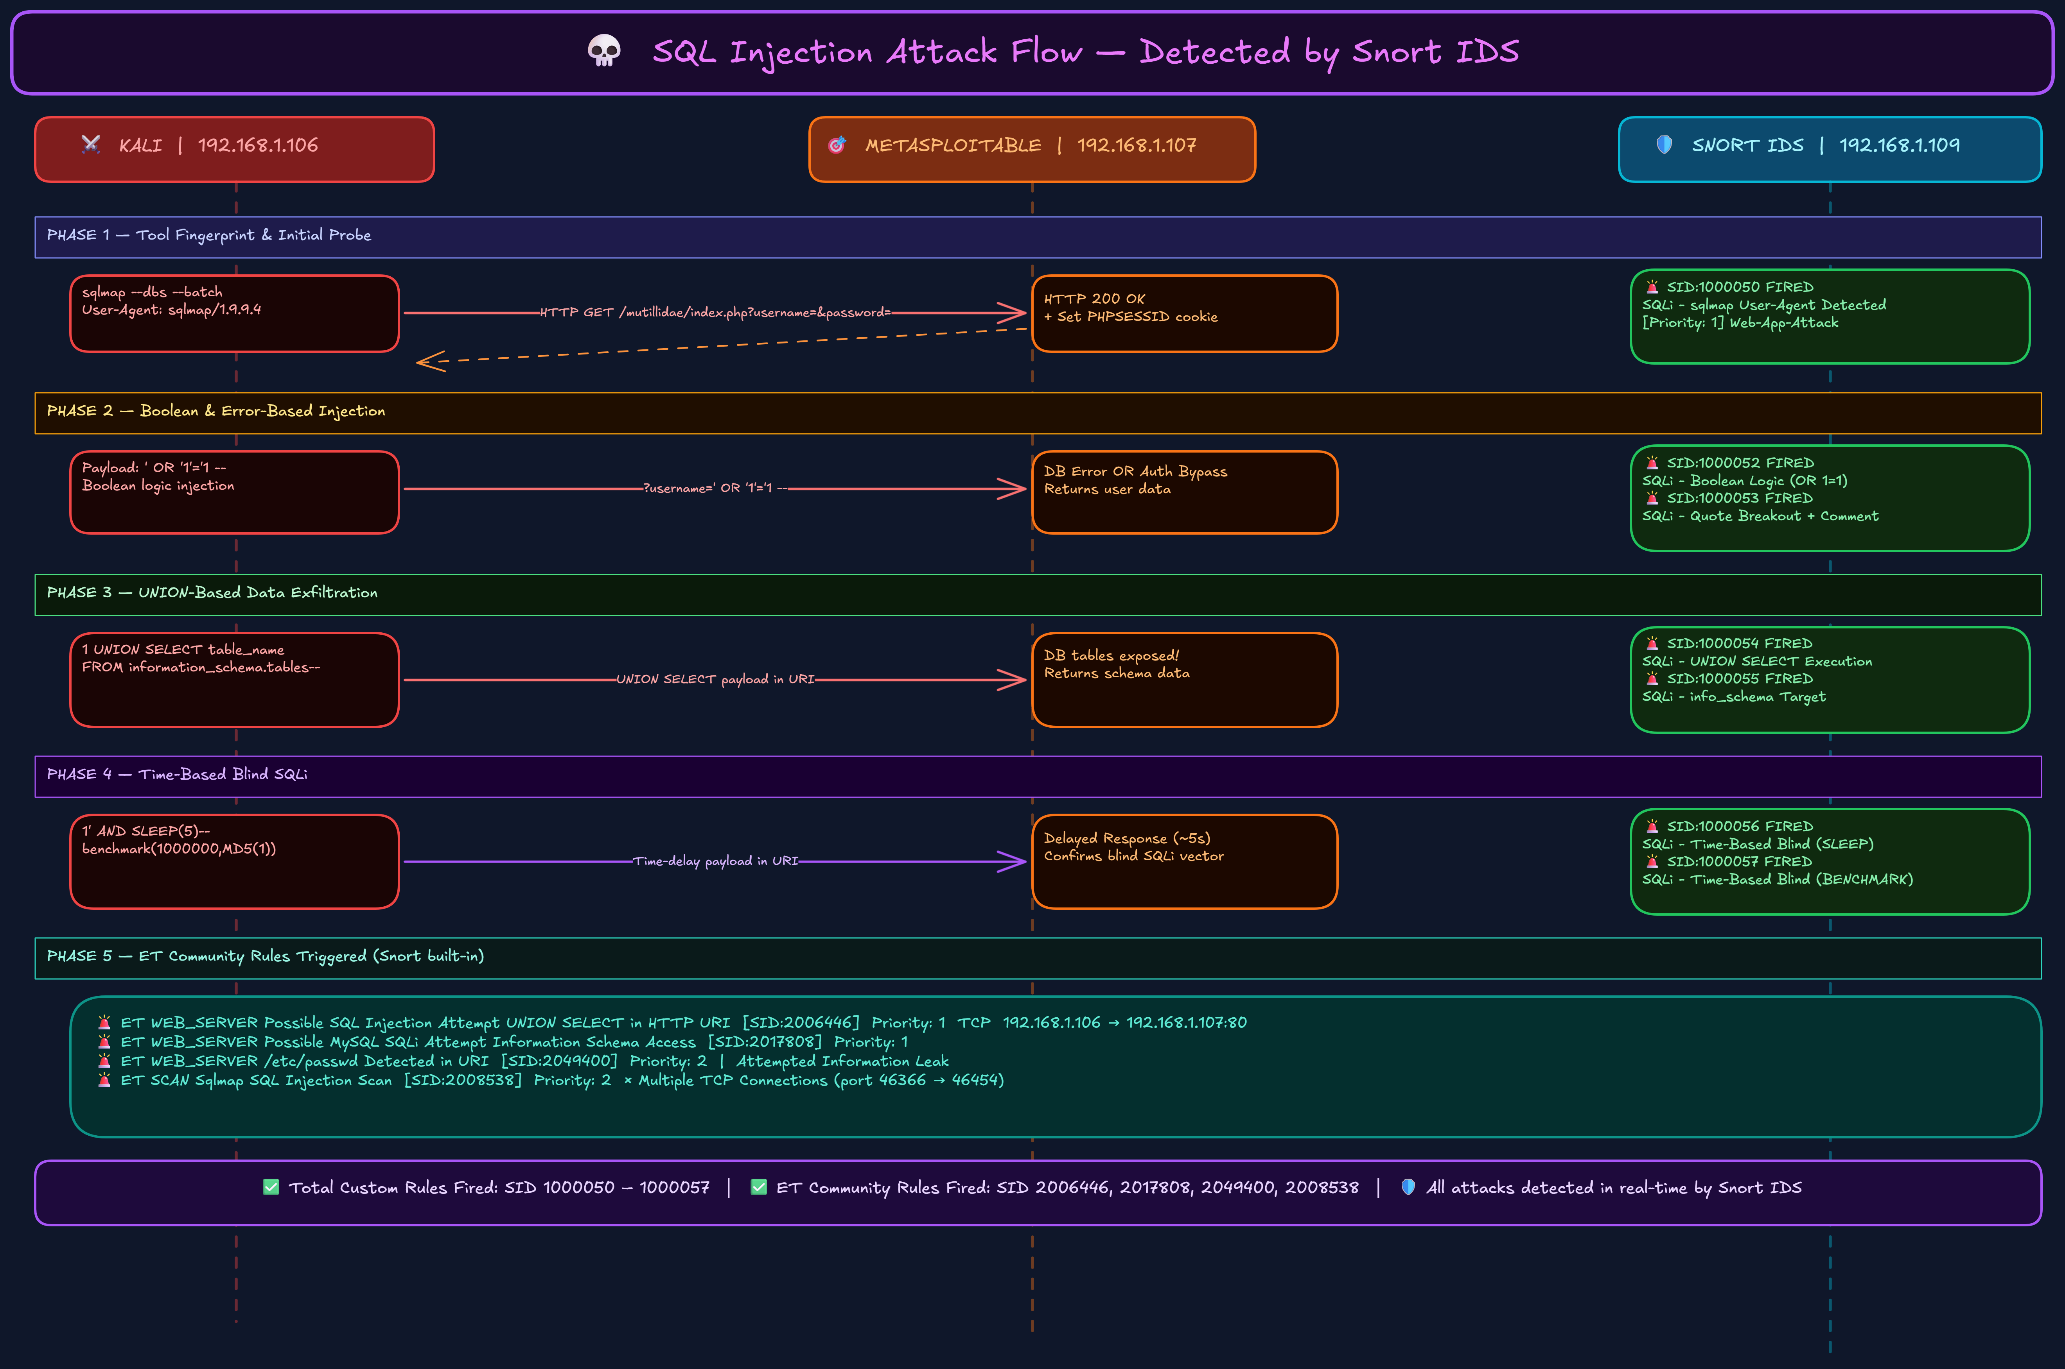

Slide 20
RULE SET 1 Detecting the Automated Tool (sqlmap)
1
Catching the Default sqlmap User-Agent
SID: 1000050
alert tcp 192.168.1.102 any -> 192.168.1.107 80 (
msg:"SQLi - sqlmap User-Agent Detected";
flow:to_server,established; content:"User-Agent|3A|"; http_header;
content:"sqlmap"; nocase; http_header; classtype:web-application-attack;
sid:1000050; rev:1;)
▸ RULE BREAKDOWN
ACTION
alert — triggers an IDS alert event
FLOW
to_server, established
DETECT
User-Agent header contains sqlmap keyword
CLASSIFY
web-application-attack | sid:1000050 | rev:1

Slide 21
RULE SET 1 Detecting the Automated Tool (sqlmap)
2
Catching sqlmap Dummy Integer Testing e.g., ?id=1234 AND 4321=4321
SID: 1000051
alert tcp 192.168.1.102 any -> 192.168.1.107 80 (
msg:"SQLi - sqlmap Dummy Integer Injection";
flow:to_server,established;
pcre:"/?.*=d{4,5}s+(AND|OR)s+d{4,5}=d{4,5}/i"; http_uri;
classtype:web-application-attack; sid:1000051; rev:1;)
▸ RULE BREAKDOWN
ACTION
alert — triggers an IDS alert event
FLOW
to_server, established
DETECT
pcre: ?param=NNNN AND NNNN=NNNN in URI (http_uri)
CLASSIFY
web-application-attack | sid:1000051 | rev:1

Slide 22
RULE SET 2 Boolean & Error-Based Logic Detection
1
Classic Boolean OR Logic catches spaces, ticks & URL encoding
SID: 1000052
alert tcp 192.168.1.102 any -> 192.168.1.107 80 (
msg:"SQLi - Boolean Logic (OR 1=1)";
flow:to_server,established;
pcre:"/(%27|')(s|%20)*(OR|AND)(s|%20)*d*(s|%20)*=(s|%20)*d*/i"; http_uri;
classtype:web-application-attack; sid:1000052; rev:1;)
▸ RULE BREAKDOWN
ACTION
alert — triggers an IDS alert event
FLOW
to_server, established
DETECT
pcre: quote + OR/AND + numeric equality (URL-encoded, http_uri)
CLASSIFY
web-application-attack | sid:1000052 | rev:1

Slide 23
RULE SET 2 Boolean & Error-Based Logic Detection
2
Quote Breakout & Comment Injection single quotes followed by -- or #
SID: 1000053
alert tcp 192.168.1.102 any -> 192.168.1.107 80 (
msg:"SQLi - Quote Breakout and Comment";
flow:to_server,established;
pcre:"/(%27|')s*(%23|--|%2D%2D)/i"; http_uri;
classtype:web-application-attack; sid:1000053; rev:1;)
▸ RULE BREAKDOWN
ACTION
alert — triggers an IDS alert event
FLOW
to_server, established
DETECT
pcre: single-quote followed by -- or # comment tokens
CLASSIFY
web-application-attack | sid:1000053 | rev:1

Slide 24
RULE SET 3 Data Exfiltration (UNION-Based)
1
UNION SELECT Execution in URI
SID: 1000054
alert tcp 192.168.1.102 any -> 192.168.1.107 80 (
msg:"SQLi - UNION SELECT Execution";
flow:to_server,established;
content:"union"; nocase; http_uri; content:"select"; nocase; http_uri; distance:0;
classtype:web-application-attack; sid:1000054; rev:1;)
▸ RULE BREAKDOWN
ACTION
alert — triggers an IDS alert event
FLOW
to_server, established
DETECT
content: "union" then "select" chained in URI (nocase)
CLASSIFY
web-application-attack | sid:1000054 | rev:1

Slide 25
RULE SET 3 Data Exfiltration (UNION-Based)
2
Database Structure Mapping targeting information_schema
SID: 1000055
alert tcp 192.168.1.102 any -> 192.168.1.107 80 (
msg:"SQLi - info_schema Target";
flow:to_server,established;
content:"information_schema"; nocase; http_uri;
classtype:web-application-attack; sid:1000055; rev:1;)
▸ RULE BREAKDOWN
ACTION
alert — triggers an IDS alert event
FLOW
to_server, established
DETECT
content: "information_schema" in URI (nocase)
CLASSIFY
web-application-attack | sid:1000055 | rev:1

Slide 26
RULE SET 4 Time-Based Blind SQLi Detection
1
MySQL SLEEP() Command Detection
SID: 1000056
alert tcp 192.168.1.102 any -> 192.168.1.107 80 (
msg:"SQLi - Time-Based Blind (SLEEP)";
flow:to_server,established;
pcre:"/(%27|').*sleep(s|%20)*(/i"; http_uri;
classtype:web-application-attack; sid:1000056; rev:1;)
▸ RULE BREAKDOWN
ACTION
alert — triggers an IDS alert event
FLOW
to_server, established
DETECT
pcre: quote followed by sleep() function call (http_uri)
CLASSIFY
web-application-attack | sid:1000056 | rev:1

Slide 27
RULE SET 4 Time-Based Blind SQLi Detection
2
MySQL BENCHMARK() Command Detection
SID: 1000057
alert tcp 192.168.1.102 any -> 192.168.1.107 80 (
msg:"SQLi - Time-Based Blind (BENCHMARK)";
flow:to_server,established;
pcre:"/benchmark(s|%20)*(/i"; http_uri;
classtype:web-application-attack; sid:1000057; rev:1;)
▸ RULE BREAKDOWN
ACTION
alert — triggers an IDS alert event
FLOW
to_server, established
DETECT
pcre: benchmark() function call in URI (URL-encoded)
CLASSIFY
web-application-attack | sid:1000057 | rev:1

Slide 28

Prompt:
You are a Digital Forensics and malware analyst expert. your work is to give slides about: "Understanding Snort Rules: Structure, Syntax, and Academic Logic Behind Signatures."
Based on your experience and knowledge, give a good subject in 10 slides. Give the core concept related to the info here and also your experience in the malware & digital forensics fields
resources:
Kali Linux: https://www.kali.org/get-kali/
Ubuntu: http://ubuntu.com/download
Virtual Box: http://virtualbox.org/wiki/Downloads
Snort 2 : https://www.snort.org/snort2
SQLmap: https://github.com/sqlmapproject/sqlmap

Slide 29
THANK YOU

